Slide 1
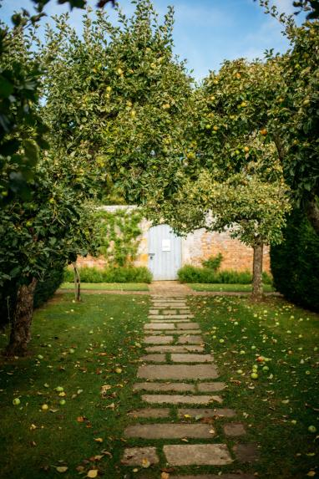
Visit Kent
Virtual Industry Update
Friday 19th June 2020

Slide 2
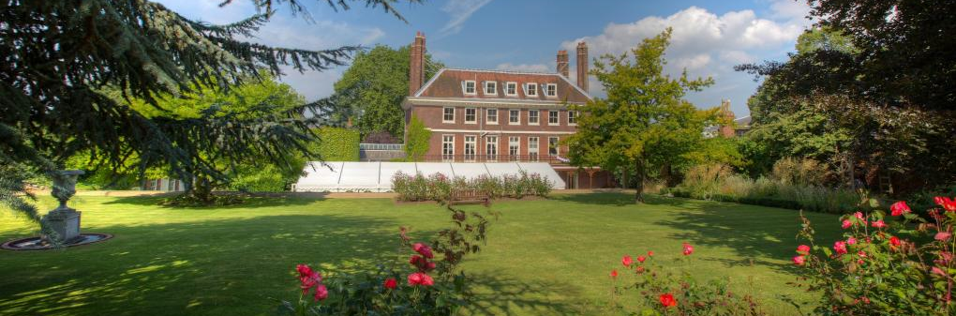
Bill Ferris OBE
Chairman, Visit Kent

Slide 3
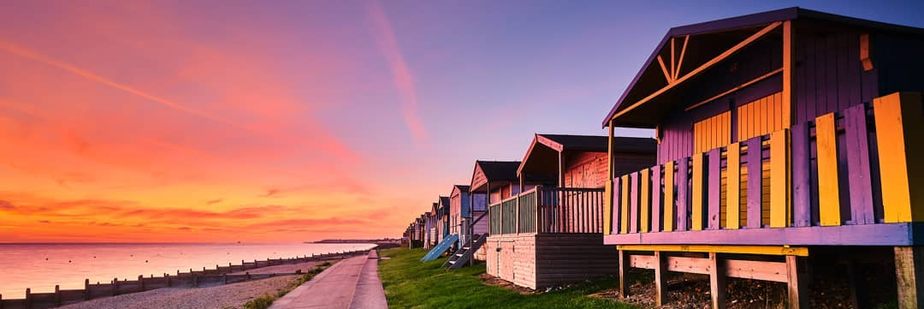
© @mals6
Deirdre Wells OBE
Chief Executive, Visit Kent

Slide 4
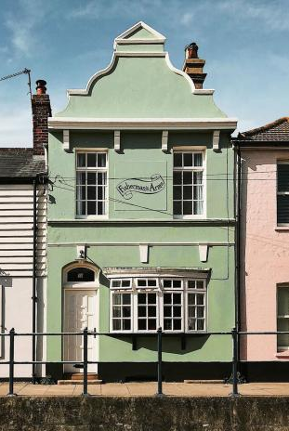
VK Covid-19 Response
Business support & recovery
Sector representation
Community engagement
Impact monitoring

Slide 5
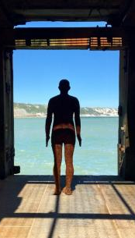
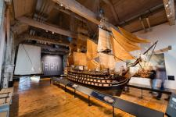
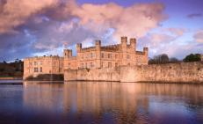
Latest COVID-19 Research
Consumer Sentiment
Some significant differences in confidence from week to week, showing the volatility of people’s perceptions and confidence
People are shopping around more to find the best deals, with more than 1 in 3 saying they are less willing to pay more for ‘extras’
Uncertainty is still high, with 36% of England intenders believing that life will return to ‘something close to normal’ by September
Looking at confidence in the ability to take a domestic short break or holiday, 36% feel confident in doing so in July/August, 62% in September/October and 71% in November/December.
Government restrictions, perceptions around less things to do and fears of catching the virus are key confidence inhibitors to visit
For visits up to September, coastal/seaside towns and countryside or village (both 32%) are the preferred destination types
Looking at accommodation preferences, hotels will be the preferred option from October onwards.
“Perceptions of crowds and whether an attraction is able to maintain social distancing is the current key determinant of a quick return”- ALVA
Notes:
According to the VisitEngland COVID weekly tracker published on the 15th of June for England, the majority of England intenders (72%) feel that things are going to stay the same or the worst is still to come, significantly more than reported in week 2 (64%).
In the context of financial products, results this week indicate that as a result of the pandemic, over half of the population is shopping around more for the best deal – including those who consider themselves wealthy or well off. More than 1 in 3 say that they are less willing, in the current circumstances, to pay more for ‘extras’.
36% of England intenders believe that life will return to ‘something close to normal’ by September, rising to 59% by the end of the year – with both figures having marginally decreased since week 2.
Although there is an increase in the proportion of people that are confident in taking a short break in the medium term (Sept-Oct), the public still anticipates taking fewer trips between now and the end of the year.
Key factors that inhibit confidence to travel are broadly the same - advice from government, concerns around catching the virus and having less things to do and fewer opportunities to eat/drink out.
While for trips between June and September the preferred accommodation type is a private home or camping and caravanning (both 36%), hotels will be the preferred option from October onwards (46%).
The ALVA research shows consumers are likely to wait to see how attractions handle and enforce their re-opening phase before committing to visit, clearly demonstrating the importance of ensuring attractions effectively communicate this to their visitors. 2
Social distancing will be the most important priority for visitors when attractions reopen, followed closely by steps that maximize cleanliness. 1
And as highlighted by ALVA, reassurance before and during a visit will be critical. Attractions must be seen to delivering and policing procedures effectively.

Slide 6
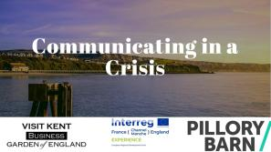
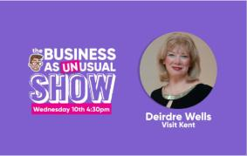
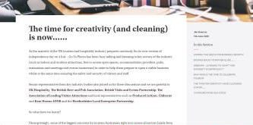
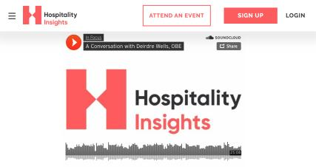
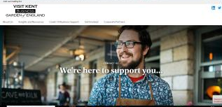
Visit Kent Activity Report

Slide 7
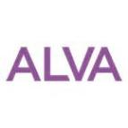
Industry Roundtables II
– coming soon!
Second phase of industry discussions across multiple destinations, to be joined by key industry bodies

Slide 8
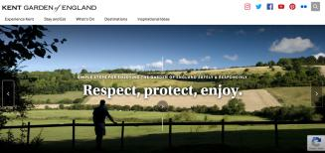
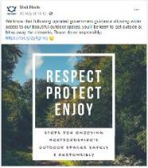
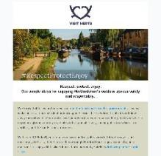
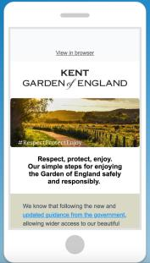
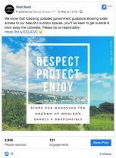
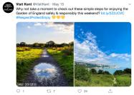
Respect,
protect,
enjoy.
Creating the right consumer-facing messaging to encourage residents and visitors to begin enjoying our open spaces safely and responsibly again.

Slide 9
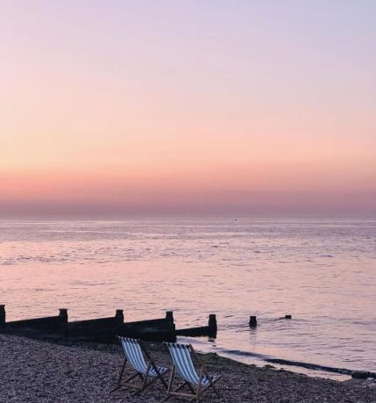
The Secret Garden of England
Consumer confidence campaign - Summer 2020

Slide 10
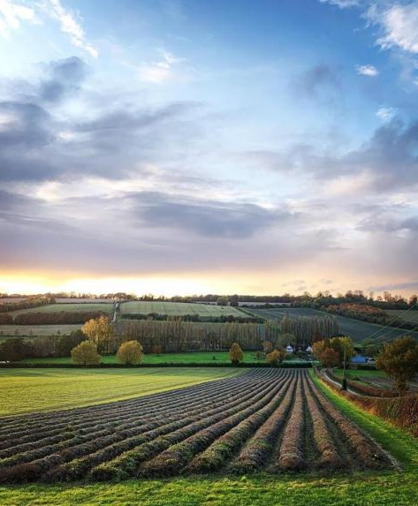
Why?
60% of people will now take more domestic holidays - GWI
Extensive consumer insights show an increase in visitors’ confidence to take a domestic short break (62% would visit in September)
The pandemic is impacting people’s attitudes, priorities, motivations to travel, media consumption, perceptions and ultimately their consumer journey
With restrictions relaxing, and building on the success of the Respect, Protect, Enjoy campaign, we want to invite key domestic segments to come and explore Kent safely

Slide 11
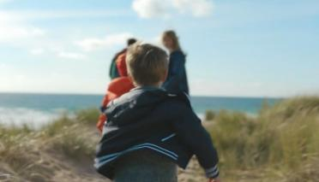
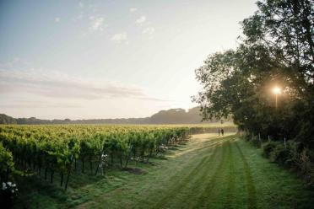
What?
Our solution is an inspirational, video-led, multi-platform campaign that looks to address the following:
Restoration of consumer confidence that Kent is a safe and desirable place to visit, targeting residents and those within a 2.5 hour travel time
Raise awareness of the range of open spaces and variety of product available across the county, showcasing hidden gems and secret spots
Build upon the Respect, Protect, Enjoy shared messaging to educate consumers, and encourage them to avoid crowded places, whilst providing guidance and safety information
“Perceptions of crowds and whether an attraction is able to maintain social distancing is the current key determinant of a quick return” - ALVA

Slide 12
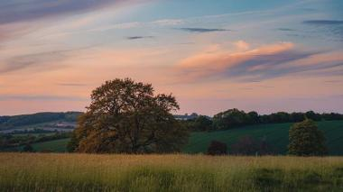
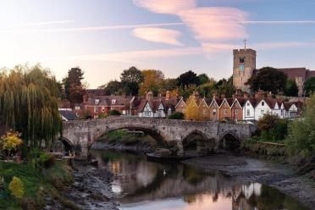
What?
Help rebuild the county’s visitor economy
Support Kent’s tourism sector, allowing the county’s destinations and businesses to be part of a wider message and promotion
A flexible campaign that can adapt in-line with evolving Government guidelines. This will ensure support for businesses that are yet to re-open (accommodation providers, indoor attractions, and wider hospitality businesses)
“For visits up to September, coastal/seaside towns and countryside or village (both 32%) are the preferred destination types” - Visit England

Slide 13
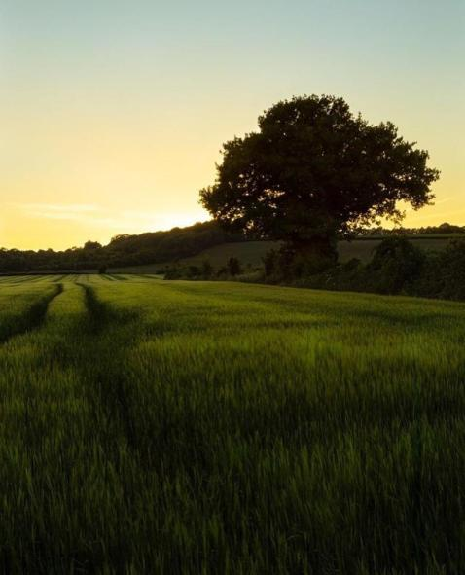
How?
Key elements will include:
A short, inspirational video composed of striking imagery and a verbal narrative, telling a compelling story with lasting visual impact
A range of complementary content including features, social media and press activity.
"Travellers are increasingly turning to videos to research what they’re going to get before they purchase" - Google

Slide 14
How?
Teads - highly targeted video seeding activity
Radio advertising - 88% of the population tuning into radio every week in the UK
Paid search - a geo-targeted PPC campaign
Paid social - highly targeted visual adverts across Instagram and Facebook
A carefully constructed campaign that delivers high impact and cost-effective activity across a wide range of media platforms

Slide 15
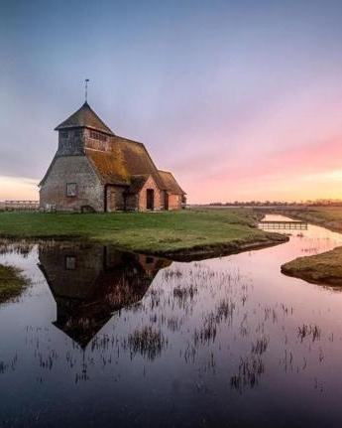
How does this differ from our usual campaign activity?
This revised approach aims to present a broader picture of Kent, celebrating the products, open spaces and opportunities countywide. This will give people the confidence and inspiration to choose our destinations when planning their next domestic trip.

Slide 16
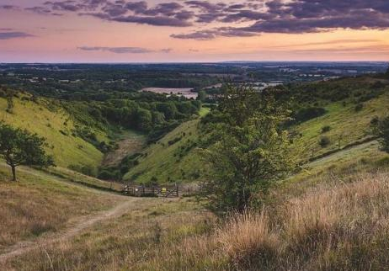
Measuring success...
Traditional measures including uplift in brand searches, website traffic and engagement, reach, impressions, click through rate and social media engagement

Slide 17
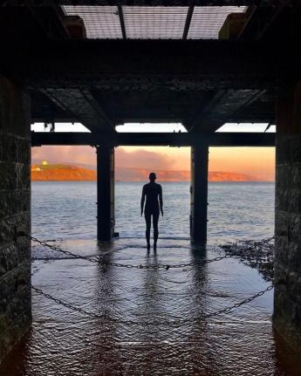
The desire for safety and certainty is guiding consumers' travel decisions and almost unconsciously driving them towards more sustainable travel choices. - GWI

Slide 18
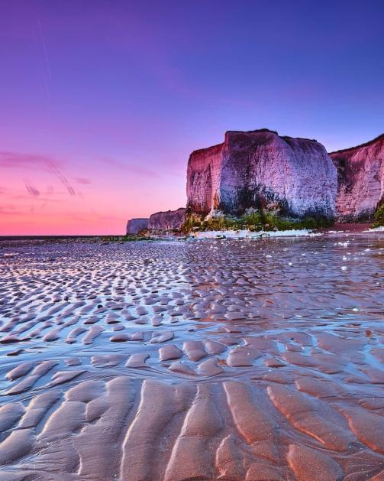
Any Questions?
© @mals6

Slide 19
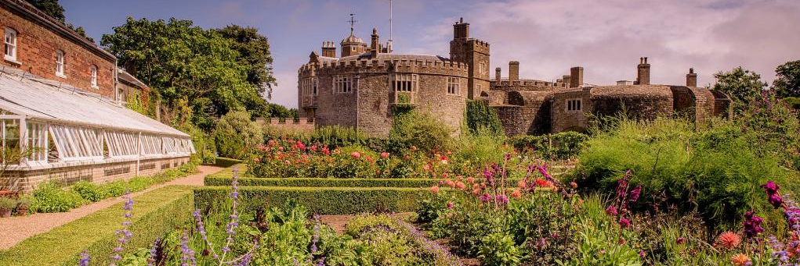
© Jim Holden
© @mals6
Andrew Stokes
England Director, Visit England

Slide 20
THE ROAD TO RECOVERY Moving towards a ‘new normal’
Consumer Marketing Recovery Plans
Update: June 2020

Slide 21
SUPPORTING YOU
We want to help your business / destination to prepare to welcome domestic and international visitors as we move towards recovery and a ‘new normal’.
The following deck provides more information on VisitBritain (VB) and VisitEngland’s (VE) consumer marketing recovery plans, including activity to date, aligned to the four phases of recovery.
We’ve outlined ways we can work together and how we’ll support you in the coming months.

Slide 22
THE PHASES OF RECOVERY
The below illustrates the four phases of recovery that VisitBritain and VisitEngland is working to.
Phase | Title | Description
1 | Crisis | The UK is in lockdown OR international markets are in lockdown. Travel restricted.
2 | Early Recovery | International markets pass the peak number of cases. Restrictions on movement start to loosen.
3 | Recovery – Manage demand | Lockdown restrictions fully lifted with continued but less disruptive containment measures.
4 | Recovery – Build & maintain demand | The UK is fully open for business. Travel restrictions are lifted with international markets open for inbound travel.

Slide 23
CONSUMER MESSAGING

Slide 24
OVERVIEW
DOMESTIC VE TO CONSUMER | INTERNATIONAL VB TO CONSUMER
Stay safe, while you can’t come visit us, enjoy Britain in our homes | Stay safe, while you can’t come visit us, enjoy Britain in our homes
While you can now travel, destinations and facilities are not fully open and ready to welcome you – build your England wish list | Inspirational message Build your Britain wish list for when you can come visit us and we are ready to welcome you! Underpinned by reassurance messages.
Inspirational & Travel Reassurance message “KNOW BEFORE YOU GO” Including: Industry Standard - We’re Good to Go Know Before You Go message Signposting tools e.g. Ordnance Survey
Welcome back campaign to build demand, possibly still carrying % travel responsibly message. | Welcome campaign to build demand – make your wish list a reality!
Scale/ Voice
Phase 1
Phase 2
Phase 3
Phase 4
Notes:
Scale v1

Slide 25
THE STORY SO FAR
Phases 1 & 2

Slide 26
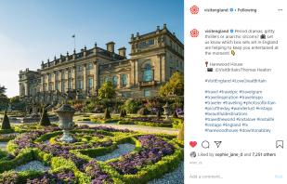
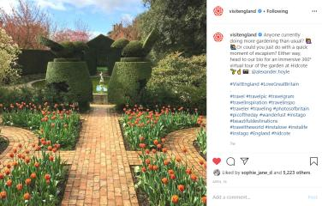
PHASE 1 – 2: CRISIS TO EARLY RECOVERY
Our consumer marketing response to COVID-19 has focused on sharing everything that is great about Britain and England – creating “armchair” travel content to help beat the boredom and keep Britain (on VisitBritain’s channels) and England (on VisitEngland’s channels) top of mind during the crisis phase.
What’s next?
For the latest updates:
VisitEngland - https://www.visitbritain.org/node/123174
VisitBritain - https://www.visitbritain.org/inspire-them-dream

Slide 27
INSPIRING THEM TO DREAM: HOW CAN YOU GET INVOLVED?
You can help us to inspire our domestic and international audiences by sharing the following for consideration and potential use on our VisitBritain and VisitEngland consumer marketing channels:
Stories of people / tourism businesses that are adapting and / or innovating in readiness for re-opening
Attractions / businesses that are planning to do ticketed or reservation-only entry
Day trip content ideas an hour or less from a major city, town or location (e.g. walks, trails, stately homes, gardens, Instagrammable villages, lesser known locations etc.) Please provide a brief paragraph on the day trip and a web link to your destination/partner website. This will help forward plan as we move towards Phase 3 of recovery.
News and major up-coming events (where applicable, including stand-out virtual experiences)
Send to: VisitEngland (for England / domestic marketing) - press@visitengland.org VisitBritain (for Britain / international marketing) - pressandpr@visitbritain.org

Slide 28
RECOVERY
Phases 3 & 4

Slide 29
DOMESTIC MARKETING CAMPAIGN - OBJECTIVES
To counter the impact suffered by the tourism industry, we first plan to deliver an integrated domestic marketing campaign that will encourage consumers to start spending but also reassure and build consumer confidence. To support the campaign, we will develop an industry toolkit offering industry and partners the chance to amplify the campaign through provision of assets, messaging, etc.
1. Reassure visitors and support the industry – to give confidence to the industry and consumers that it is safe to travel managing the distribution and benefits of tourism across the regions.
2. Build demand campaign and generate bookings –welcoming visitors back to the country’s amazing tourism offer. It will encourage visitors to explore more of their country, get off-the-beaten-path and tap into the pent-up demand that lockdown has generated stimulating economic growth.
Get healthy UK residents who are either eager to get out and travel after lockdown OR those who may feel uneasy about travel
To feel confident and well informed about how to travel responsibly in line with Government advice
By promoting responsible ways to travel (e.g. check before you go) and signposting to open businesses through a warm, friendly and motivational pan-Britain message
Get UK & Ireland residents who are healthy and able to travel
To be inspired to take a domestic break late summer and into autumn 2020 as well as plan for 2021
By promoting open, exciting and inspiring experiences available on their doorstep here in the UK

Slide 30
REASSURANCE CAMPAIGN – “KNOW BEFORE YOU GO”
As lockdown continues to lift, we need to put the onus on the public, both domestically and Internationally, to find out what is open and when – helping destinations and SMEs to manage demand as we move between phases 2 - 3 and 3 - 4.
‘Know before you go’ is a clear and simple message that compels those intending to travel both to the UK, and within the UK, to check before setting off.
See example creative mock-ups below:
DRAFT

Slide 31
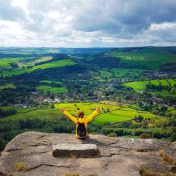
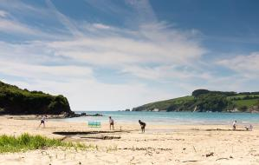
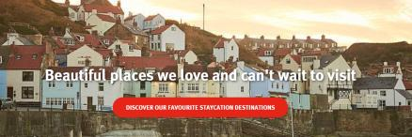
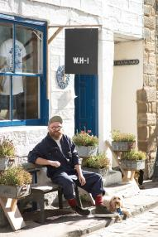
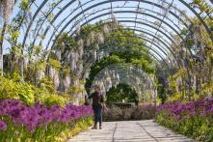
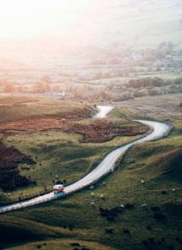
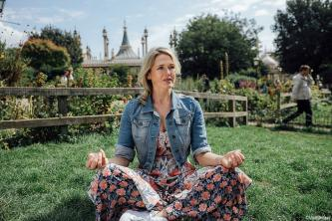
VISUAL MOODBOARD FOR BUILD DEMAND CAMPAIGN – FINAL CREATIVE TBA

Slide 32
THE INDUSTRY STANDARD

Slide 33
“WE’RE GOOD TO GO” – INDUSTRY STANDARD
The British Tourist Authority (BTA) is launching an Industry Standard. UK tourism and hospitality businesses will have the opportunity to pledge that they have made modifications in line with Government guidelines, have taken all reasonable steps to ensure social distancing and have a system in place to ensure regular cleaning is undertaken.

Slide 34
AN INDUSTRY STANDARD – WHY?
COVID-19 Recovery – Industry Standard
A call to action from across the industry – it is critical to early recovery
To give confidence to the businesses, support and encourage them to show they have clear processes in place
To give reassurance to the visitor – clear consumer messaging isn’t enough and needs to be backed up by a consistent and robust process followed by businesses
To aid reassurance to local residents – that tourism is not the enemy
Avoid confusion in messaging and recognition by offering a nationwide consumer ‘marque’ that the whole industry can get behind
Deliver global recovery best practice

Slide 35
WE’RE GOOD TO GO – THE PROCESS
COVID-19 Recovery – Industry Standard
Online Self Certification that includes:
Non-negotiable confirmation that Government Visitor Economy Guidance and Public Health England Guidance have been read and understood
Non-negotiable confirmation that a Covid-19 Risk Assessment is in place
A question set that enables us to recognise key membership bodies willing to share their detailed guidance with any business applying
Agreement and understanding that spot checks by assessors and the call handling centre will take place at random and un-announced (around 5% of those awarded the mark)
On successful completion the applicant can download the ‘We’re Good to Go’ mark including a toolkit on how to use it and a certificate to display
Knowledge that if either of the key guidance documents from Government and Public Health changes an alert from us will be sent out by email
Notes:
Does everyone agree with my third bullet? Think there will need to be some guidance given on how to display and use the marque and connect that up with the wider campaign/consumer message?

Slide 36
A final word:
Please support your
Destination Management Organisation
THANK YOU

Slide 37
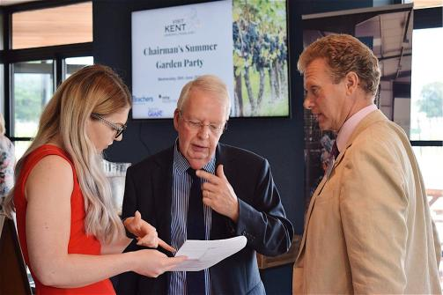
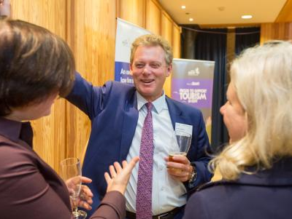
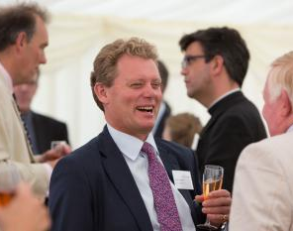
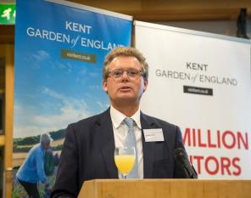

Slide 38
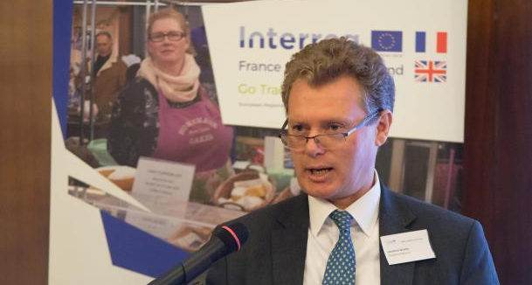
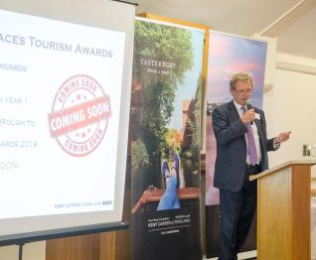
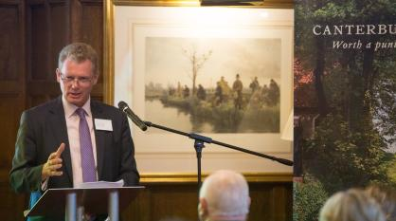

Slide 39
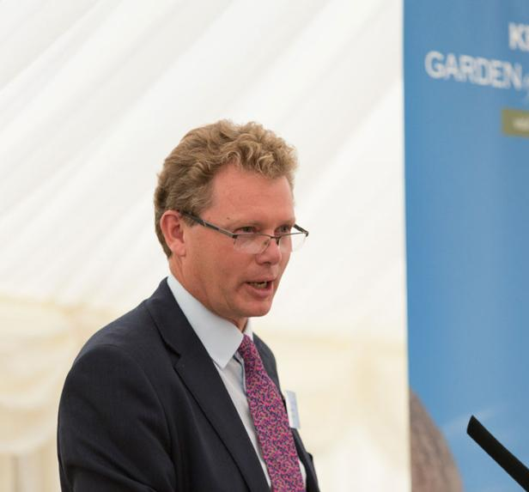
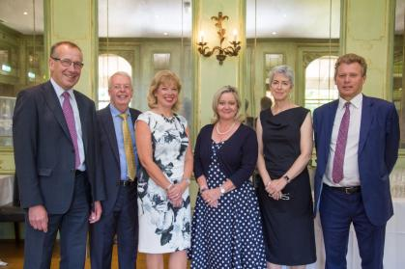
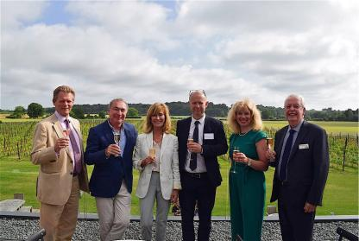

Slide 41
Bills Ferris OBE

Slide 42
Until next time…
Late Summer / Autumn 2020

